Slide 1

Jean Louise/ Scout’s
IPhone
Click HERE to indicate the ringtone for your character’s phone, as well as at least one verse/ chorus of the song.

Slide 2
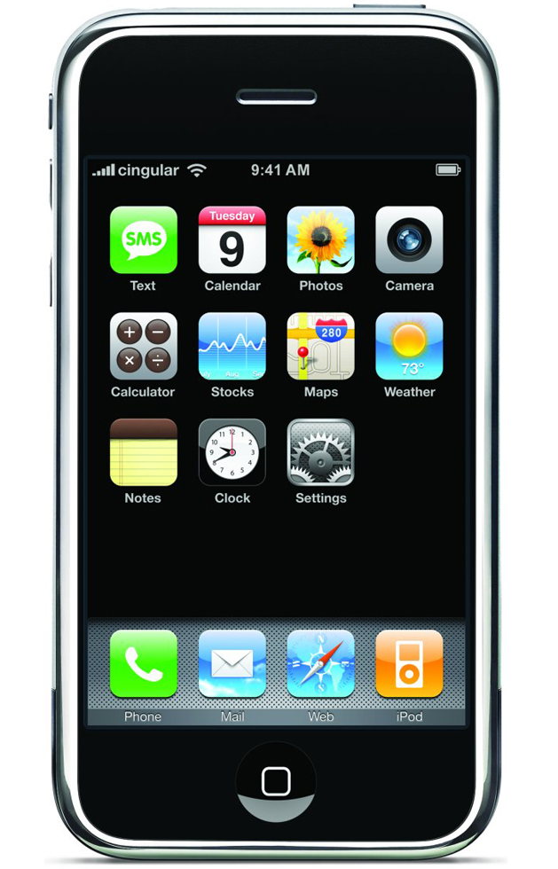






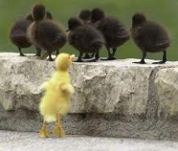

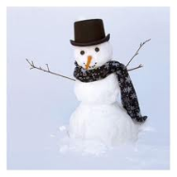

Use the grid below to help you link your app. To create a link, right click, the hyperlink
Change the color of your app button by right click, format shape
4 | 5 | 6 | 7
8 | 9 | 10 | 11
12 | 13 | 14 | 15
16 | 17 | 18 | 19
iSchool
Mind Reader
Flashlight
Forgetfull
Lie Detector
How To
Fitting In
No Troubles
Snowmen
Alarm
Name of app
Name of app
Name of app
Name of app
Name of app
Name of app

Slide 3
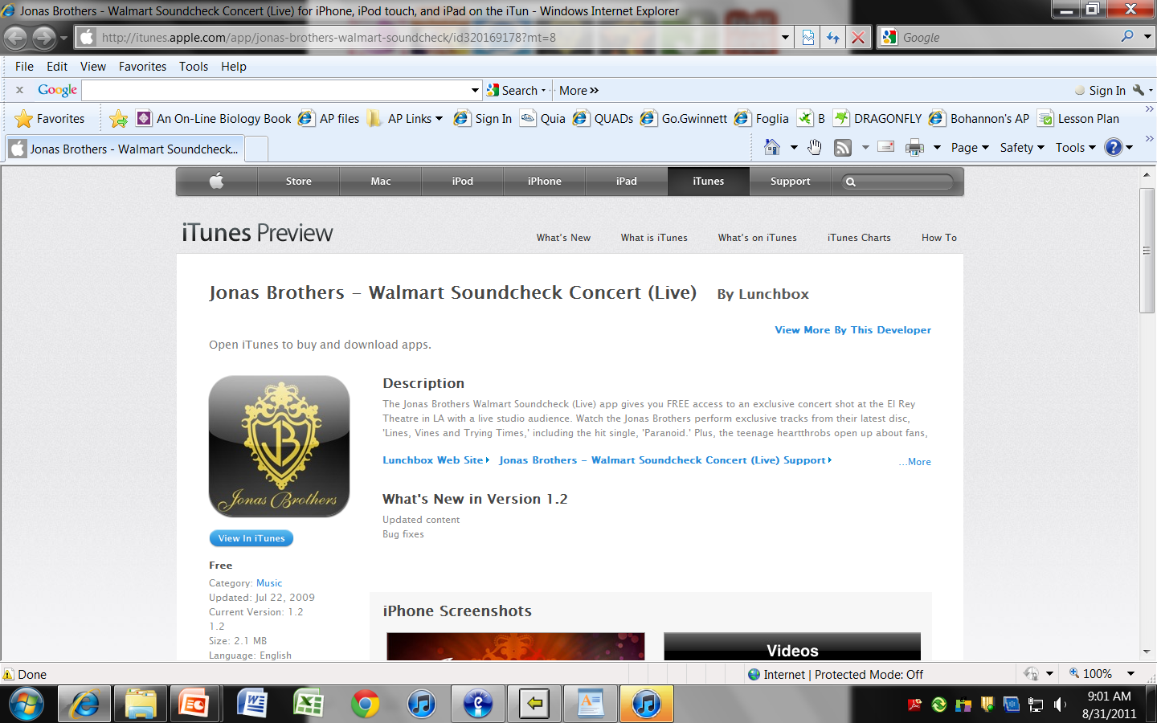

iSchool
Home
iSchool is an app that lets you learn at the rate you want to. If your class is moving at to slow of a pace then you can use this to learn what you want. Scout entered school and was really bored because she already knew everything the teacher was teaching. This app would have helped her to go ahead and learn at the pace she wanted to.

Slide 4
Home
Mind Reader
Mind reader is an app that tells the personality and feelings of a desired person. It tells you if they are mean, nice, funny etc. and also tells you if they are happy, sad, excited etc. If scout had used this app she would have been able to tell from the beginning if Boo Radley was crazy or if he was actually nice. Some of the things that happened to her would not of had to happen if she had been using this app.

Slide 5
Flashlight
Home
Flashlight is an app that brightens an area up to a certain distance. This app would have been very useful to Scout a few times. She could have used it when they were running away from Boo Radley’s house. She could have used it to see better in front of them while trying to get away from Mr. Radley. Another time it would been useful is when Mr. Ewell was following them on the way back from the play Scout was in. Scout could have used it to see who was there when they first heard the noise and they would have been able to get away before anything happened.

Slide 6
Forgetful
Home
Forgetful is for the times you accidently leave things behind. You put in to the app everything you have with you so when you are leaving if you have forgotten anything it will alert you that something is missing. Scout could have used this to make sure she did not forget her shoes at the play. If she had not forgotten them she would been able to run better when Bob Ewell was chasing them.

Slide 7
Lie Detector
Home
Lie detector is self explanatory it tells if the person is lying or telling the truth. When the person is talking you hold down the button and let go when they are done talking. If the screen turns red it is a lie and if it turns green then it is the truth. Scout could have used this by giving it to Atticus to tell if Bob Ewell was lying about if he abused or raped Mayella. This could have helped Tom Robinson be set free.

Slide 8
How To…
Home
This app can pretty much tell you how to do anything. If you need help fixing a car it tells you what parts you need etc. Whatever you need done but don’t know exactly how to do it, it can tell you how. Scout could have used this to know how to be more ladylike. It would help her know what kind of clothes to wear and the way she talks.

Slide 9
Fitting In
Home
This app helps people know how to fit in better. If you need to impress people or just need to be in a group this app can help you. It can tell how you need to act and the things you need to wear to impress the people you are with. This app would have helped scout by helping her fit in with Jem and Dill. It could have told her how to act like them so they would think she was cool enough to hang out with them.

Slide 10
No Troubles
Home
This app helps people come up with excuses and other ways for people to get out of trouble. If you need a lie you can go under the lie section and then type in what you need a lie for. After this it will give you a whole list of lies to use. Scout could have used this so she would not get in trouble with Atticus. If she comes home late or does anything else bad like going into Boo’s backyard she can already have a list of excuses ready.

Slide 11
Snowmen
Home
This app tells people the kinds of things they can do when it snows. It tells how to make snowballs, snow angles, snowmen, and even thing to do indoors when it snows. It shows how much how much snow you need and how to shape it right. Scout could have used this when she and Jem made a snowman on the day it snowed. They would have known how to make the snowman without all the dirt in.

Slide 12
Alarm
Home
This app helps you know when it’s time to go somewhere or wake up or just about anything else you need to remember to do. You type in what time you are going to do something and it lets you know when it’s time. This app would have helped Scout wake up before the play started. This way she would not have just walked onto the stage during the play.

Slide 13
Click here to name your app 11
Home
Resize your app icon and paste here
Click here to type your description of the app and to give details as to why your character would need or use this app…

Slide 14
Click here to name your app 12
Home
Resize your app icon and paste here
Click here to type your description of the app and to give details as to why your character would need or use this app…

Slide 15
Click here to name your app 13
Home
Resize your app icon and paste here
Click here to type your description of the app and to give details as to why your character would need or use this app…

Slide 16
Click here to name your app 14
Home
Resize your app icon and paste here
Click here to type your description of the app and to give details as to why your character would need or use this app…

Slide 17
Click here to name your app 15
Home
Resize your app icon and paste here
Click here to type your description of the app and to give details as to why your character would need or use this app…

Slide 18
Click here to name your app 16
Home
Resize your app icon and paste here
Click here to type your description of the app and to give details as to why your character would need or use this app…

